Slide 1
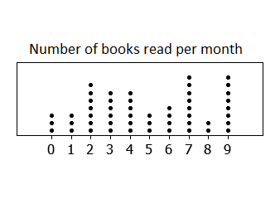
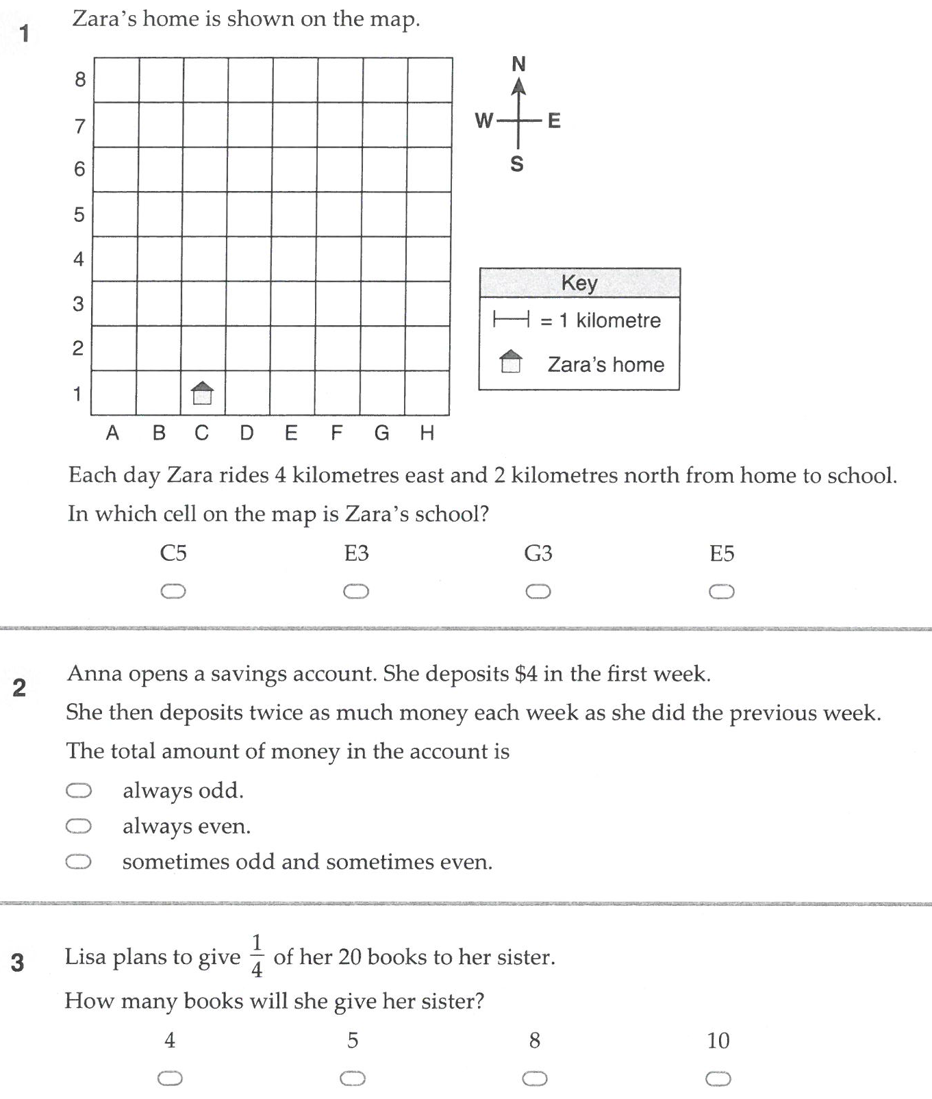
1. Answer the following
4+- 7 =
6-(+3) =
7 - - 9 +-4=
-3 + + 3 =
2. Explain how you would find the mean, mode, median and range of the following dot plot
3. What angle is supplementary to 110º?
4. What is the area of a rectangle 6cm long by 4 cm high?
Warm Up
5

Slide 2
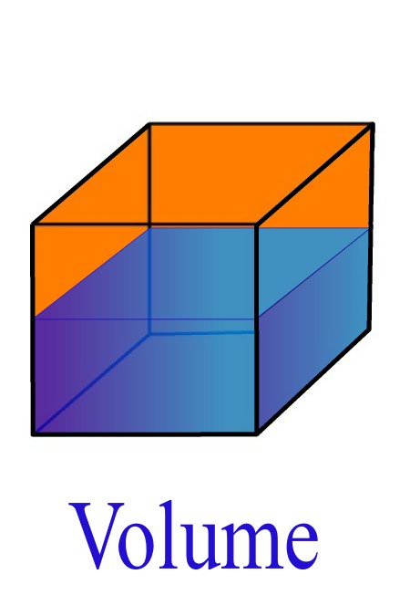
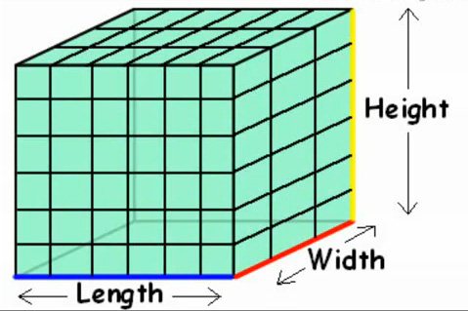
My Volume
Interactive Notebook
Name:
Class: 7
Teacher:
Term 2 Semester 1

Slide 3
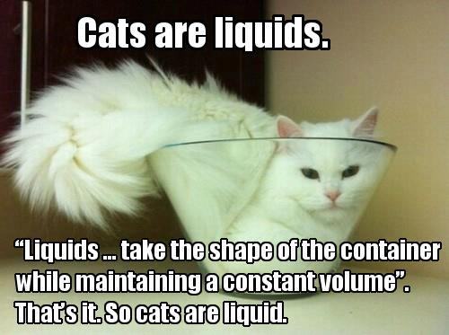
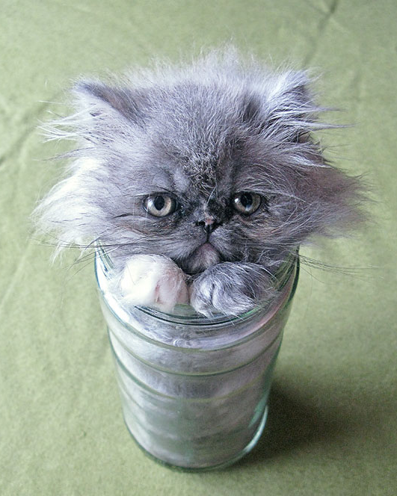
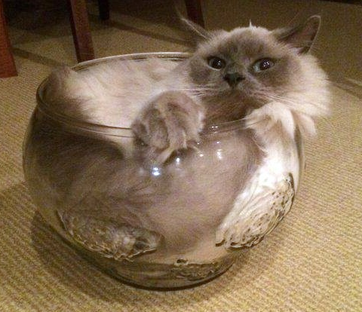
24
7
30
Topic: Volume
Date
EQ – What is volume, and how to we find it?
Volume is the amount of space occupied in three dimensions
Liquids are measured in volumes
  Like your water bottle
  Or cat……
What is volume?

Slide 4
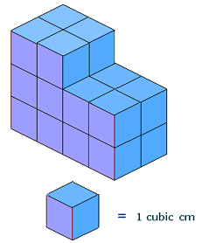
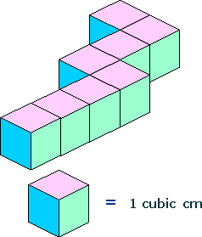
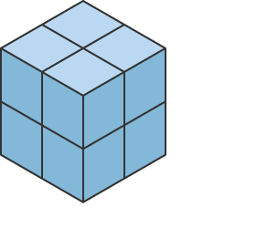
24
7
30
Topic: Volume
Date
EQ – What is volume, and how to we find it?
How would I find the volume of the following three shapes?
You add the blocks up
How to find volume?
8
20
8

Slide 5
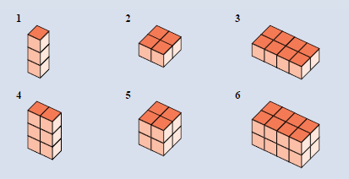
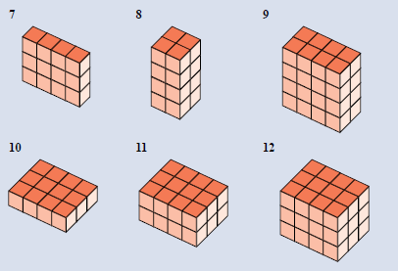
Task
Find the volume of the following blocks
This is Exercise 8.1 page 104 Dwyer

Slide 6
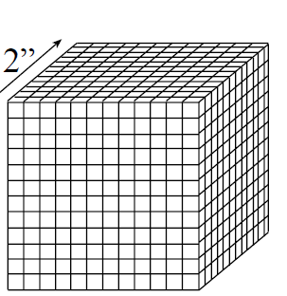
24
7
30
Topic: Volume
Date
EQ – What is volume, and how to we find it?
Is there an easier way than just adding up blocks?? Imagine adding all these blocks
How to find volume?

Slide 7
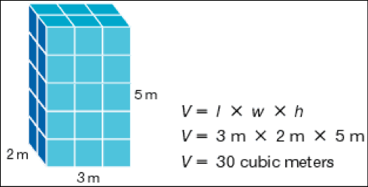
24
7
30
Topic: Volume
Date
EQ – What is volume, and how to we find it?
How to find volume?
Volume = Length x Width x Height

Slide 8
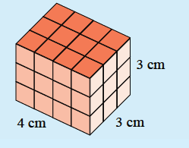
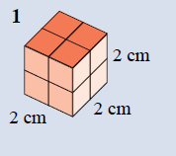
Examples
Volume = Length x Width x Height

Slide 9
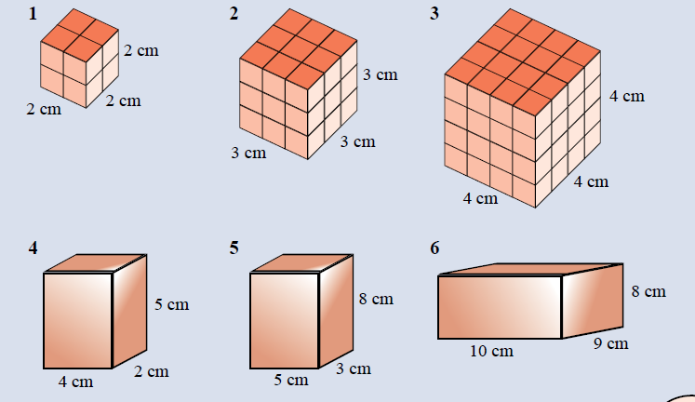
Task
This is Exercise 8.2 page 105 Dwyer

